Slide 1
C++ Input/Output
Presented by S.R.ZAMEER

Slide 2
C++ Input/Output
Any language uses input/output data from/to the user which shows its success rate. CPP Input/Output streams are also present to receive the data and send the data from a program. This action requires keyboard to provide an input and monitor screen to provide the output.
A stream can be defined as an entity through which a program can send and retrieve the data.

Slide 3
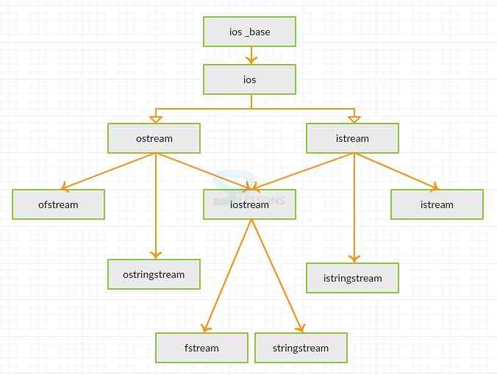
A stream can be divided into various types shown as below.

Slide 4
CPP Input/Output Stream | Description
cin | Input Stream
cout | Output Stream
cerr | Output Stream
clog | Output Stream

Slide 5
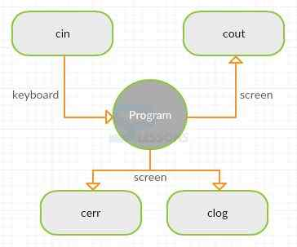
Input or output statements

Slide 6
cout
The stream ‘cout’ is an output stream and is an instance of ostream class. cout gives the output to display screen by using stream insertion operator <<. More than one output in a single statement can also be given.
To see any output on the screen, there are two ways.
Enter the desired statement in double quotes" ".
Assign the statement to a variable and enter the variable without any quotes
The variables or the statements which are to be displayed must be after insertion operator.( << ). By default, cout does not end the line with any special characters. “\n” or endl can also be used to go to next line.

Slide 7
cin
The stream ‘cin’ is an input stream and is an instance of istream class. cin takes the input from keyboard by using stream extraction operator >>. This stream waits till the input is entered. More than one input in a single statement can also be given.

Slide 8
cerr and clog
Both “cerr and clog” are similar to cout belonging to ostream class.
cerr connected to error device, gives the output immediately as the data in it is not buffered.
clog is also connected to error device, but gives the output with a gap as the data is stored in buffer.
It loads the output only when the previous output is erased and the buffer becomes empty.

